Slide 1
PSG HACKATHON 2022
Anantha Raman S (20PC05)
Dhanush M (20PC12)

Slide 2
Crime detection Model using Network Analysis
Overview:
It is highly dangerous to travel to new places without knowing the crime history of that place, the model we propose would analyze the district based on the past crime history, help you visualize and suggest you if it is safe to travel to that place or not, and what are the necessary precautions you need to take while traveling.

Slide 3
Data Given
Analysis of 14 years of data (2001 to 2014).
District wise crime and Place wise crime analysis.

Slide 4
Solution Proposed
Solution Via Network Analysis
Modeling the given data into graph to predict the future outcome

Slide 5
Why Graphs? Why not regular ML model
Benefit of traversal
The presence of edges can explain the relationship between crimes, their place of occurence, possible Victims etc

Slide 6
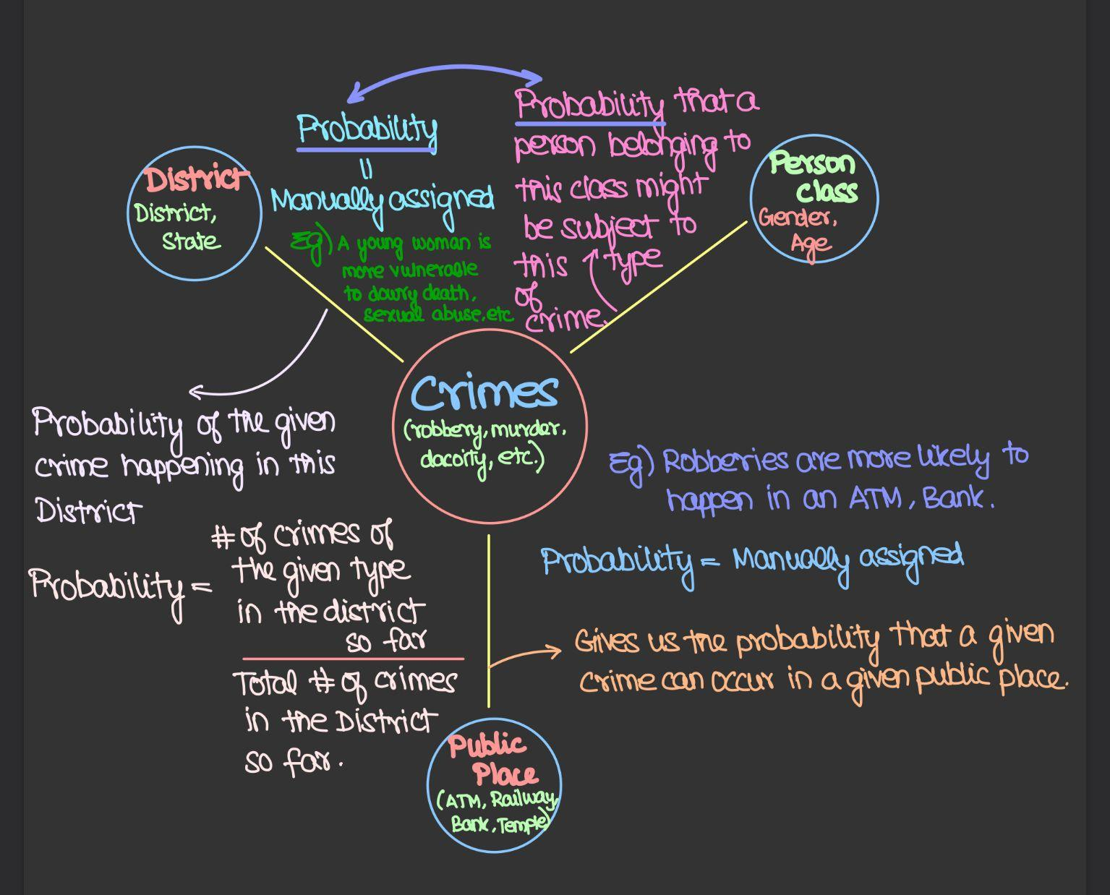

Slide 7
How the model works?
Rough idea:
The input from the user(age, gender,travel details etc) is received from a simple flask application.
Then the given data is located on the network graph.
The threats are analysed with the help of neighboring nodes and edges.
The user is then warned about the possible threats that are likely to occur during his/her course of journey.
Safety recommendations and hotline numbers are provided to the user.

Slide 8
Step 1: Data Pre-Processing
District Wise:
The given district wise data set had entries for the year 2001 to 2014.
The data set from 2001 to 2013 had around 33 categories of crime, whereas the data set for the year had around 90+ crime categories.
The categories were merged with one another in such a way that the there were no redundant crime and no crimes were left out.
All the data set were merged to one data frame for further process.
Place Wise:
The given place wise data set had entries for the year 2001 to 2014.
The data set from 2001 to 2013 had around 34 categories of crime, whereas the data set for the year had around 81 crime categories.
The categories were merged with one another in such a way that the there were no redundant crime and no crimes were left out.
All the data set were merged to one data frame for further process.

Slide 9
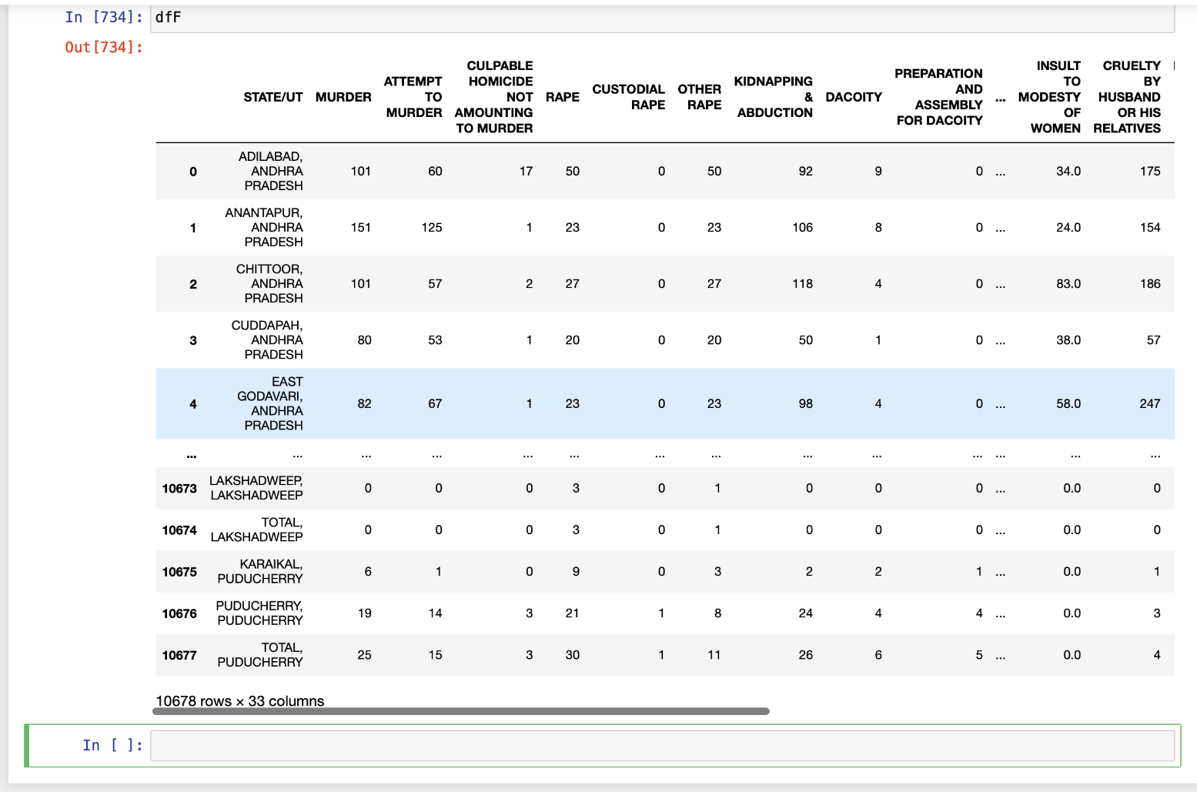

Slide 10
Step 2: Construction Of Graph
Components in graph(node):
People class
Crime type
District
Public Places
Each edge signifies what kind of relation does the node have.
Edge weight represents the probability of the crime associating the two nodes.

Slide 11
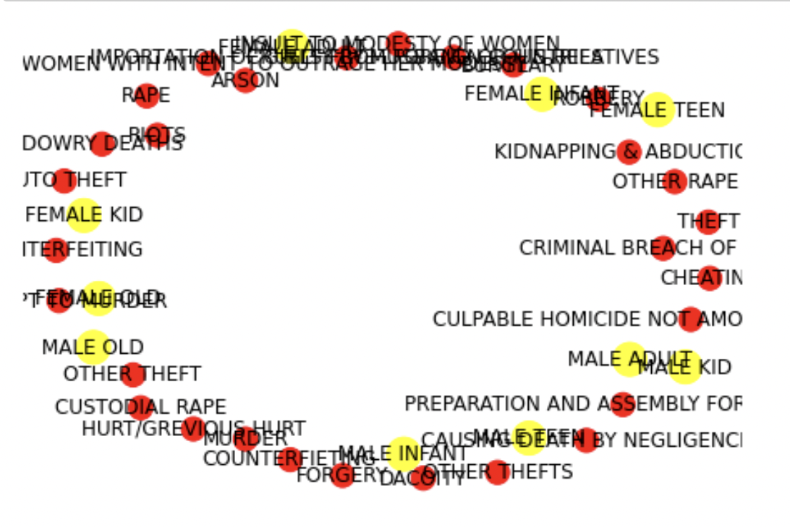

Slide 12
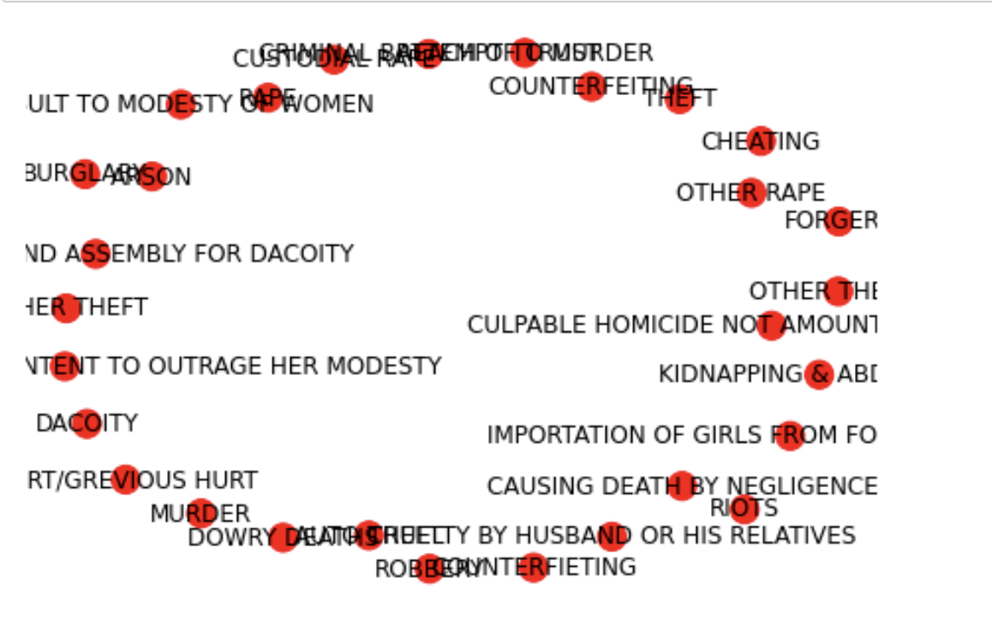

Slide 13
Step 3: Input From the user
Person Class and Location of travel are feed to the system by the user.
We would then find out where the user input would be placed in the graph.
Based on the results of the graph we predict what are the crime which are most likely to occur.
User are warned for the same.

Slide 14
Things which we tried, but didnt go well
Try to host the product as a webpage
Safety score
Hotline number recommendation
Safe accommodation recommendation

Slide 15
Thank you for providing us with the opportunity to learn and grow 😃

